Slide 1

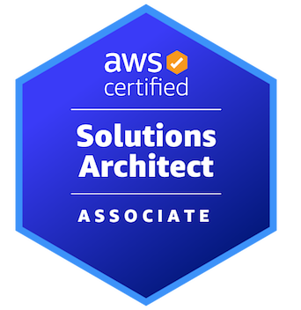
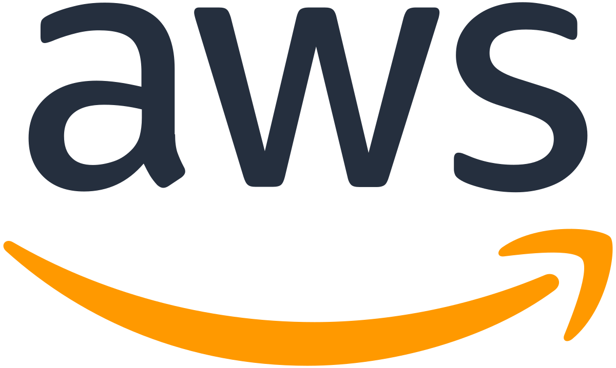
AWS CERTIFIED SOLUTIONS ARCHITECT - ASSOCIATE
Preparing for the Exam
AMBER ISRAELSEN
Developer | Technical Trainer
Notes:
m20-01 = “Module Introduction”
Hello there, and welcome back everyone! This is the AWS Certified Solutions Architect – Associate course, and I’m your guide, Amber Israelsen.

Slide 2
Course Outline (Part 2)
Monitoring
Security and Compliance
Automation and Governance
DNS and Network Routing
Application Integration
Machine Learning
Backup and Recovery
Billing and Pricing
The Well-Architected Framework
Preparing for the Exam
Notes:
Show https://d1.awsstatic.com/training-and-certification/docs-sa-assoc/AWS-Certified-Solutions-Architect-Associate_Exam-Guide.pdf
We’ve made it through all of our modules—yay! Thanks for sticking with me!
We’ve covered a TON of stuff as we’ve worked our way through these domains, and I know it can seem a little overwhelming at times. But don’t worry.
(to slides)
In this final module, I’m going to give you some practical pointers to help you check whether you’re ready to take the exam, and if not, some resources that you can use for additional study. We’ll also go through the mechanics of actually registering for and taking the exam.
So let’s go.

Slide 3
DEMO
Reviewing the Exam Guide
Notes:
m20-02 = “DEMO: Reviewing the Exam Guide”
Have open: https://d1.awsstatic.com/training-and-certification/docs-sa-assoc/AWS-Certified-Solutions-Architect-Associate_Exam-Guide.pdf
Let’s start on the official certification home page from AWS: https://aws.amazon.com/certification/certified-solutions-architect-associate/
This gives you a nice summary of what’s involved, but let’s go back to the official exam guide.
As you know, we’ve been referencing this guide to show the various exam domains. But let’s skim through some of the other parts, and I’ll call out the important points.
Before taking the exam, it’s recommended that you have 1 year of experience, or equivalent, of active engagement with AWS. That 1 year is obviously not a hard requirement, but I think the hands-on experience is absolutely critical to understanding. So if you haven’t already been following along with the demos in this course, I’d recommend going back and doing them side-by-side with me. It will greatly improve your understanding vs. just watching slides or watching me do the demos. And obviously, you can poke around and try things out beyond what I’ve showed as well.
As far as question format, there will be multiple choice, where you have one correct choice. And there will also be questions where you have two or more correct responses, and it will tell you in the question where multiple answers are expected.
You’ll see the note here that there are 50 questions that affect your score, and just below that, 15 questions that don’t affect your score. There’s no way to know which are scored or unscored. AWS is always refreshing their exams and kind of testing new questions, so they get thrown in but not counted.
Your exam results will be scored from 100-1,000, with a minimum of 720 required to pass. When you’re done, you won’t actually see a pass or fail OR a score. That will come in an email later—up to 5 days later, but you’ll never see scores or answers for individual questions.
Moving down to the exam domains—these are the percentages that each makes up on the exam, and then scrolling down, a WHOLE LOT of bullet points. And we’ve hit on these things throughout the course. It’s worth noting that you might not get questions about every single thing here in the guide—after all, there are only 65 questions total, and there’s 17 pages of this exam guide! But it’s still a good idea to make sure you’re familiar with the services and concepts here.
And then as an appendix, here’s a non-exhaustive list—meaning there might be things on the exam that aren’t on here and vice versa—of the different tools and technologies covered.
And then scrolling down a bit more, the out-of-scope things. So you shouldn’t get questions related to things on this list.

Slide 4

TIPS AND PRACTICE QUESTIONS
Notes:
m20-03 = “DEMO: Test-Taking Tips and Sample Questions”
As someone who’s taken lots of technical certifications in my career, I’ve picked up a few strategies and tips along the way that have served me well. Hopefully they’ll help you too.

Slide 5
Amber’s Tips
Read the questions carefully
Look for qualifier phrases such as “least expensive,” or “with the least amount of effort”
There may be more than one correct answer
You can usually eliminate two answers right away because they don’t make sense (“the distractors”)
Correct answers:
Are usually simple
Usually involve an AWS managed service
Notes:
In no particular order, here are the tips.
First—it may seem obvious, but read the questions carefully. I’ve definitely missed things because I skimmed through the question too fast. (click) Keep an eye out for qualifier phrases such as “least expensive” or “with least amount of effort.” For example, if the question is asking about setting up a relational database, and your options are to spin up an EC2 instance and manually install the database vs. just using the managed Relational Database Service, then the Relational Database Service will be less effort. Both will work, but RDS is least effort.
Also, as you’re reading the questions, if there’s more than one correct answer, that will be noted. Make sure you pick as many answers as it says.
Next, you can usually eliminate two answers right away because they just don’t make sense. These are included as a way to distract you. After you eliminate those two, you’ll usually just be left with two answers that COULD be right, and you’ll just need to study them and pick the correct one.
As far as what’s correct, generally speaking, the correct answer will be simple. If there’s a question that says you could do 5 different things with 3 different services, that’s probably not the correct answer. Again, I’m generalizing, but that’s a good rule of thumb
And kind of related to what I mentioned in the first bullet, most of the times, if you’re given a choice between setting up or configuring something manually versus using an AWS managed service—where they deal with the infrastructure and provisioning and so on—the managed service will usually be the right answer. That’s actually in the Well-Architected Framework, so you can assume that the exam will be pushing you that direction as well.

Slide 6
Amber’s Tips
Make your first pass through all questions, answering things you’re sure of
Flag the others to come back to
Make a second pass on all questions if you have time
Sometimes a question later in the exam will help you remember an earlier answer
Never leave a question unanswered
It will automatically be marked wrong
Guessing at least gives you a chance
Practice on the sample questions and official practice exam
Notes:
More tips! Try to make your first pass through all questions and answer things that you’re sure of. Hopefully this will be the majority of things where you won’t have to spend too much time to come up with the right answer. This will mean you’re less stressed about running out of time, AND you’ve seen all the questions so you know what you’re up against. For anything you’re not sure of, you’ll be able to flag it in the testing software and easily come back to it, hopefully with plenty of time to really study the options.
And I personally like to make a second pass on ALL questions, even if they were easy on the initial pass. Sometimes I’ll realize that I mis-read something or I jumped to a conclusion too soon. Or sometimes, as you go through the later questions, they’ll trigger something that makes you remember an earlier answer, so you can go back and change it.
Next, never leave a question unanswered. It will automatically be marked wrong. If you have no idea what the correct answer is, it’s better to guess. Then you at least have a 25% chance—in most cases—of getting it correct.
Now let’s move on to the sample questions. I’ve included lots of questions here in the course itself, along with a full practice exam.
But going back to the home page for the cert, another thing I’d highly recommend you do is to download the sample questions. There are 10 questions here, along with answers at the bottom that should give you a good sense of the format of the questions, how they’re worded, and most importantly, if you understand the topics they’re testing.
To walk through just the first one, A company runs a public-facing three-tier web application in a VPC across multiple Availability Zones.
Amazon EC2 instances for the application tier running in private subnets need to download software
patches from the internet. However, the EC2 instances cannot be directly accessible from the internet?
Read through the answers, pick the one you think is correct, and then you can check your answer down at the bottom. I also like these samples because there are explanations of why that’s the correct answer.
So I’d recommend you go through these as an initial check to see how prepared you’re feeling for the real exam.
And then in addition to those questions, AWS offers an official practice exam that’s free to take. On the exam home page, scroll down to the gray section (Prepare for your exam) and click AWS Official Practice Question Set.
This will take you to AWS Skill Builder, where you’ll need to log in.
And then from there, you’ll pick AWS Certification Official practice Question Sets, and then your language. I’ve actually already completed this myself, but Start Learning Now. And then from here, there’s ANOTHER site to go to, which is BenchPrep…just follow the link here. I’ve also already used the access code and have an account on this site. If you don’t already, sign up for an account—it’s free and easy to do. Then redeem the access code, and you’ll eventually be taken to the questions.
Since I’ve already taken this one, I can only go back to review my answers at the moment. But you’ll see here on the Question Review screen what kind of questions are being asked. And if I Review one of them (top one), this layout is different than what you’ll get when you take the exam, but this was the question, and then I had five options for answers. This particular question asked for two answers—so again, remember that, and make sure you’re choosing as many as it’s asking for. So you’ll pick your answer, and then after you’ve finished the exam, you can come back and review the answers here, where you get an explanation along with links to learn more.
Once again, these tests are free, and a good way to get familiar with the question formats and how things are worded. You only get 20 questions, so not the full 65 that you’ll get on the real exam, but this practice exam does have a timer, so you get some practice with how the real exam will feel when you’re under a little bit of time pressure.

Slide 7
DEMO
Registering for the Exam, Cost and Vouchers
Notes:
m20-04 = “DEMO: Registering for the Exam, Cost and Vouchers”
Now let’s talk about actually registering for the exam.
You can do that from the main certificate page for the exam: https://aws.amazon.com/certification/certified-solutions-architect-associate/
In the exam overview section, you’ll see some additional information about the exam—that you get 130 minutes, it’s 150 USD, and 65 questions. The exam providers include Pearson VUE and PSI. They both offer testing globally, and both offer online proctoring as well, meaning you can take the exam at home. In-person testing centers are also available if you prefer that—and that information will be available during the registration process.
Schedule an exam
This will require you to have a separate AWS Certification account. If you don’t have one, it’s free and easy to set up, but log into that once you have it.
Once you’re logged in, go to Exam registration or Register for an Exam. And this will give you a list of eligible exams that you can take. Some exams have pre-requisites, so you’re only going to see things that you’re qualified to take.
Choose your preferred provider. I’ve actually only ever taken tests with Pearson VUE, but you’ve got the two options here. And then it’ll walk you through whether you want to do the test online or in-person, you pick your time and eventually check out and pay (click, but only show first page).
Now, a quick heads-up, if you’ve taken other AWS exams, you can get up to 50% off the cost of this exam Back on the main certification page (certmetrics.com/amazon), if you go to the Benefits tab. When you take an AWS exam, you usually get a voucher for your next exam. So if you’ve never taken an AWS exam, this wouldn’t apply to you. But if you have, you should see exam discounts down here for 50% off. You just need to claim the benefit, which will give you a code. Then you paste that code in when you go to check out for the Solutions Architect exam, and you’ll get 50% off. It’s a pretty good deal!

Slide 8
What to Expect
ONLINE
AT A TESTING CENTER
Check in 30 minutes prior to exam
Required to run a system test (for video and audio)
Required to show ID
Required to show the proctor pictures/video of your surroundings
Wired Internet connection recommended (you might not be able to resume if disconnected)
Digital scratchpad provided in software
Will be monitored via your web cam
Arrive early
Required to show ID
Place personal belongings in a locker
Scratchpad and marker provided (have to give back at the end)
Will be monitored during the exam
Notes:
m20-05 = “Exam Day! What to Expect”
All right. You’ve done your studies, done your practice questions, and the day has arrived to take the actual exam. Let’s go through what to expect. And this will vary depending on whether you’re taking it online or at a testing center.
For online, you’ll be required to check in 30 minutes prior to the exam. This will give you time to run a system test for video and audio, show your ID and show the online proctor your surroundings. You’ll receive specific rules about this, but generally it’s things like no one can be in the room with you, you can’t have a second monitor or another laptop next to you, you can’t have your cell phone with you, can’t be wearing a watch, that kind of thing.
And the recommendation is to use a wired internet connection. If you get disconnected, you may not be able to resume the test and you’ll have to start over.
Most exams will have a digital scratchpad or whiteboard feature that lets you do rough calculations or think things through on “paper.”
And then you’ll be continuously monitored throughout the exam via your web cam.
If you’re taking the test in-person at a testing center, again, you’ll want to arrive early. They’ll check you in, have you show your ID, and then ask you to place your personal belongings such as cell phone in a locker or secure area. They’ll give you a scratchpad and a marker or pen so you can do calculations or think things through on paper. You are required to hand this back afterwards.
And then you’ll be monitored during the exam by the proctor at the testing center.

Slide 9
After the Exam
Will NOT see whether you passed or failed right then
Within five days, you should receive:
A pass/fail result (hopefully pass! ☺ ), with a final score
A “meets competencies” or “needs improvement” for each domain
A digital “badge” to proudly display, showing you’re certified
Notes:
After you complete the questions and usually a brief survey, the exam period is officially over. Hopefully you passed! But you won’t get your actual score at that time, or even a pass/fail.
But then within a few days, you should receive your exam results. This includes a pass/fail result, along with your final score—somewhere between 100 and 1,000 points. And then for each of the four exam domains, you’ll get a “meets competencies” or “needs improvement” rating.
And then in addition to those results, you’ll also receive a digital badge that you can share on LinkedIn and other places letting the world know you’re officially certified.

Slide 10
What’s Next?
Let me know how I did!
Leave me a review
Let me know how YOU did!
In your review, let me know how you did on the exam, and any tips that really worked well for you
Notes:
m20-06 = “Thank You and Next Steps”
All right! We’ve made it to the end of the course—thanks for sticking with me! I know we’ve covered a lot, and it hasn’t always been easy. But you made it, and hopefully learned a lot along the way not only for the exam, but practical skills you can use in your AWS career.
So what’s next? Well, first, I’d really appreciate it if you let me know how I did. Leave me a review for the course. This really helps me know what’s working or not, and is also great for other students and potential students as they evaluate what course to take.
Also, let me know how YOU did! In your review, let me know in the comments how you did on the exam, and any tips that really worked well for you.

Slide 11
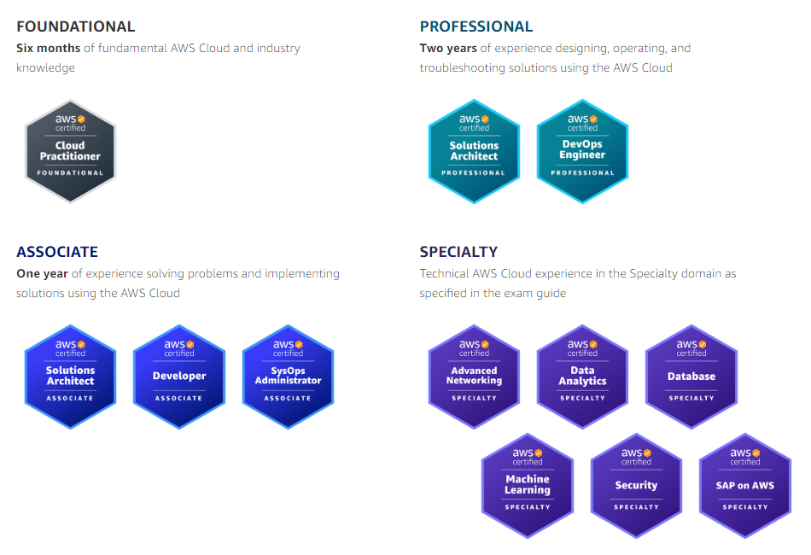
Continue Your AWS Certification Journey
Notes:
And lastly, continue your AWS certification journey. This exam is obviously at the (click) associate level, for those with 1 year of experience. There are many others for you to pursue as you learn more and look for ways to prove your skills—whether you want to move on to the professional level and/or get one of the specialty exams shown on the lower right there. There are lots of possibilities!

Slide 12
THANK YOU!
Notes:
And with that, I’ll say thanks so much for watching the course! I hope you found it helpful, and I wish you all the best in your AWS adventures!

